Slide 1
FRAUDLENT CLAIM DETECTION
Vibha garg
Siva sankar
Vinay saraf

Slide 2
EXECUITVE SUMMARY
Analyzed claim data to identify fraudulent patterns.
Model to detect fraud with high accuracy.
Identified key risk indicators such as high claim amounts and long approval times.

Slide 3
BUSINESS PROBLEM
Insurance fraud leads to financial losses annually.
Manual claim review are time-consuming and inconsistent.
Need for an automated ,data –driven fraud detection solution.
Detect and prevent fraudulent claims early in the process.

Slide 4
DATA OVERVIEW
Data includes claim amount, claim tyoe,customer demographics and approval time.
Target varaiable fraudulent or legitimate claim.
Balanced mix of numerical and categorical fetures.
Revelaed some missing values and outilers.

Slide 5
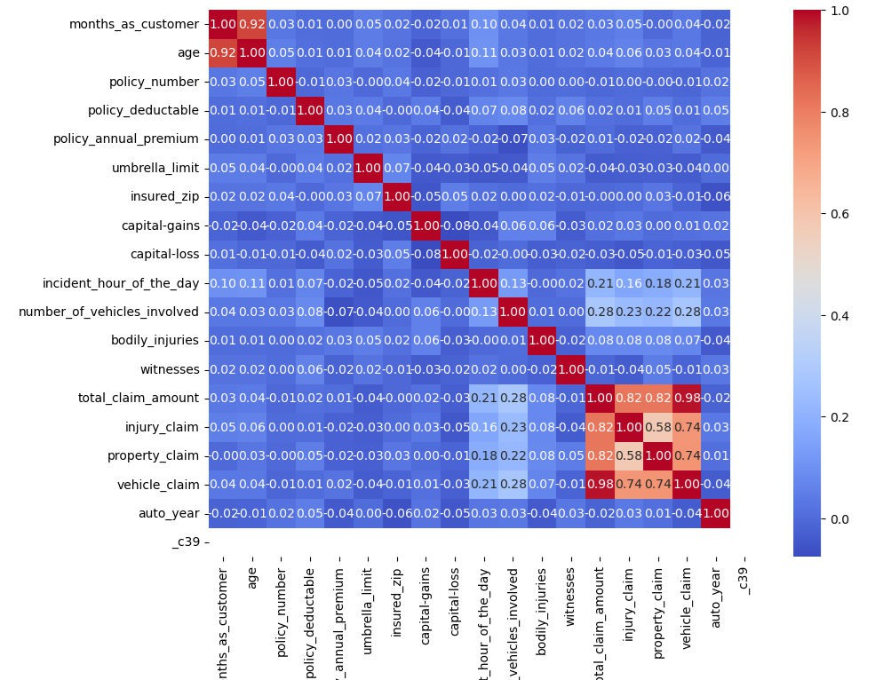
EXPLORATORY DATA ANALYSIS (EDA)
Fraudulent claim generally have high amount and longer approval times.
Visual tools used : histograms , box plotsnd correlation heatmaps.
Detected and key patterns that feature selections.

Slide 6
FEATURE ENGINEERI NG& PREPROCESSING
Handled missing values using imputation techniques.
Converted categorical varaiable using one hot encoding.
Normalized numerical features for better model performance
Created new features such as claim to income ratio and approval time bins.

Slide 7
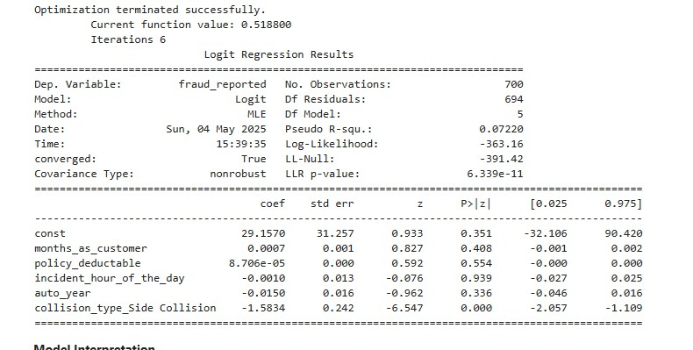
MODELING APPROACH
Logistics Regression & random forest
Random forest was selected for its balance of accuracy and interpretability
Performed hyper parameter cross-validation
Split data into traning and testing sets 80/20

Slide 8
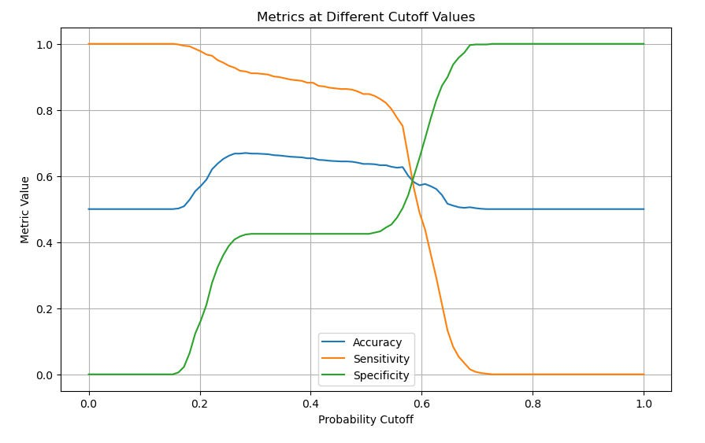
MODELING EVALUATION
Evaluation model using accuracy precision , recall .
High recall ensured most fraudulent claims were detected.
Matrix and Roc curve used to visualize performance .
90% accuracy .

Slide 9
BUSINESS IMPACT RECOMMEDATIONS
Automated fraud detection can reduce manual workload and financial losses.
Use model predictions to flag high- risk claimfor review.
Continuously update the model with new data to maintain performance.
Existing claim processing work flows.

Slide 10
ANSWERS TO THE QUESTIOS:
.
How can we analyse historical claim data to detect patterns that indicate fraudulent claims.
Exploratory Data Analysis (EDA) and machine learning models are used to examine past claim data in order to find trends, correlations, and anomalies. Fraudulent activity is sometimes indicated by patterns such as excessively large claim amounts, frequent claims, or lengthy approval times.

Slide 11
Which features are the most predictive of fraudulanet behaviour.
Features such as claim amount, approval time, claim type, and customer claim history were found to be highly predictive. The model highlighted that higher-than-average claim values and specific claim categories are closely associated with fraud.
Based on past data, can we predict the likelihood of fraud for an incoming claim?
Yes, we can precisely assign a probability score indicating the possibility of fraud for every new claim by using labelled previous data to train classification models. This makes it possible to proactively identify dubious assertions for examination.

Slide 12
What insights can be drawn from the model that can help in improving the fraud detection process. The model helps prioritize claims by risk level, improving investigation efficiency. Insights such as feature importance allow insurers to focus on key fraud indicators and update policies to reduce vulnerabilities

Slide 13
THANK YOU

